Slide 1
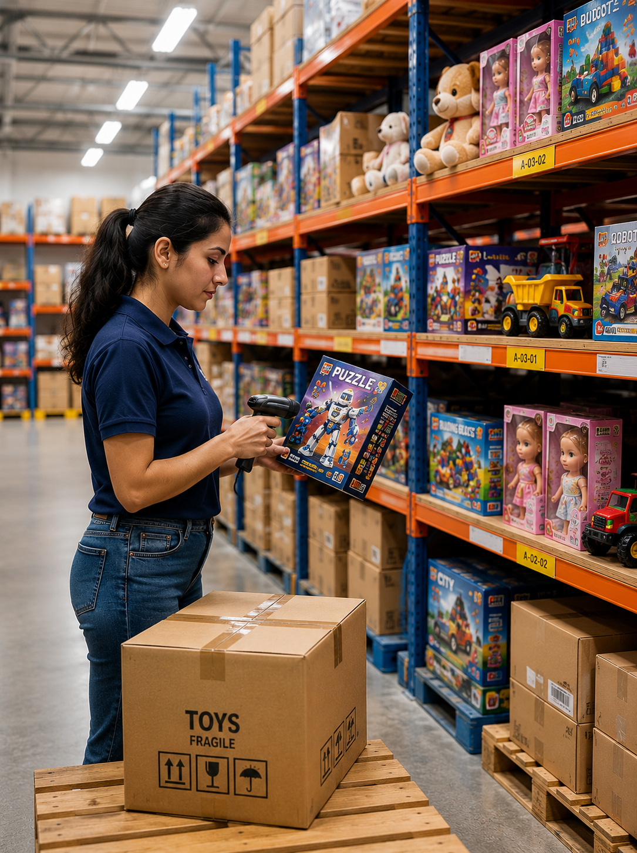
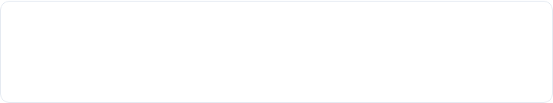
EXECUTIVE BUSINESS REPORT
TOYJOY SEASONAL INVENTORY MANAGEMENT & OPTIMIZATION
A Data-Driven Analysis of Inventory Health, Seasonal Demand & Replenishment Strategy
PREPARED BY
DEPARTMENT
Agamya Jain | Business Analyst
Business Intelligence & Analytics
ANALYSIS PERIOD
REPORT DATE
April 2023 – March 2026 (3 Years)
August 2026 | Portfolio Edition
ToyJoy Seasonal Inventory Management & Optimization Analysis
Slide 1 of 11

Slide 2






Strategic Project Objectives
Data-driven strategic initiative designed to resolve warehouse overstock, eliminate high-demand stockouts, and optimize cash flow efficiency across 10 core product lines.
Understand Seasonal & Historical Demand Patterns
Optimize Inventory Allocation & Replenishment
Identify Overstock & Slow-Moving SKUs
Identify products and categories with excess inventory or low sales velocity and assess where inventory levels may be tying up working capital. The analysis will help distinguish healthy inventory levels from products requiring inventory reduction or closer monitoring.
Analyze historical sales patterns across months and seasons to identify recurring fluctuations in product demand. These insights will help determine when inventory levels should be adjusted to better align replenishment with expected demand.
Develop product-level inventory recommendations by balancing demand, stock availability, inventory turnover, and excess-stock risk. The objective is to establish a more effective replenishment approach that reduces both overstock and stockout situations.
Key KPIs Tracked:-​
Total Revenue | Excess Inventory Value​ | Inventory Turnover​ | Units Sold​ | Inventory Value​ | Stockout Rate(%)
ToyJoy Seasonal Inventory Management & Optimization Analysis
Slide 2 of 11

Slide 3
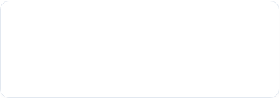
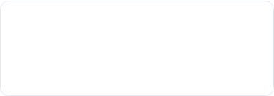
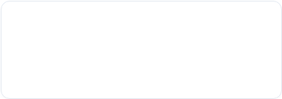
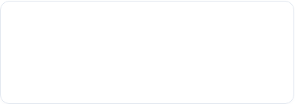

Executive Performance Dashboard
Total Revenue
Excess Inventory Value
Avg Inventory Turnover
₹32.13M
₹207.70M
48.50
₹32,132,799 Total sales across 3 years
Overstock threshold >2x sales
Units Sold ÷ Average Inventory
Product Category
Stockout
Seasonal
Inventory Adjustment
Store Allocation
Replenishment Strategy
Recommendation
Total Units Sold
Avg Inventory Value
Stockout Rate
53,601
₹39.42K
0.17%
100% data audit completed
Average inventory investment
Low systemic stockout risk
Analysis Flow:-
ToyJoy Seasonal Inventory Management & Optimization Analysis
Slide 3 of 11

Slide 4



Q1. Which products or categories have excess inventory that ties up capital?
Top 10 Products by Excess Inventory Value (₹M)
Excess Inventory Value by Category (₹ M)
Capital Concentration
Category Exposure
Management Implications
Monopoly Classic: ₹37.43M excess inventory — highest among all SKUs.
Robo Defender and Baby Doll Deluxe follow at ₹29.91M and ₹24.33M.
Top 3 SKUs ≈ 44% of total excess inventory value.
Board Games: ₹66.08M — highest excess inventory value.
Action Figures: ₹53.07M — second highest.
Top 2 categories ≈ 57% of total excess inventory value.
Prioritize high-value excess SKUs for inventory reduction.
Review replenishment quantities for Board Games & Action Figures.
Focus on releasing working capital without creating future stockouts.
ToyJoy Seasonal Inventory Management & Optimization Analysis
Slide 4 of 11

Slide 5
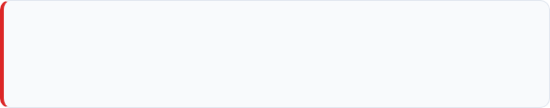


Q2. Which products are frequently out of stock, causing lost sales?
Stockout Product Table
Demand vs. Stockout Risk
Product Name | Category | Stockout Count | Stockout Rate | Inventory Turnover | Total Revenue | Total Units Sold
Princess Doll | Dolls | 5 events | 0.95% | 63.32 | ₹3.70M | 6,731
Baby Doll Deluxe | Dolls | 2 events | 0.37% | 62.71 | ₹4.44M | 6,845
SuperHero Warrior | Action Figures |  | 0.42% | 52.49 | ₹4.08M | 5,832
Adventure Puzzle | Puzzles | 0 events | 0.00% | 42.76 | ₹2.34M | 4,680
Animal Puzzle | Puzzles |  | 0.00% | 43.28 | ₹1.87M | 4,688
Chess Master | Board Games |  | 0.00% | 36.91 | ₹2.33M | 4,237
Family Ludo | Board Games |  | 0.00% | 40.48 | ₹1.38M | 4,620
Jigsaw Puzzle 500 | Puzzles |  | 0.00% | 43.88 | ₹2.20M | 4,895
Monopoly Classic | Board Games |  | 0.00% | 42.56 | ₹4.80M | 4,800
Robo Defender | Action Figures |  | 0.00% | 56.61 | ₹5.01M | 6,273
Stockout Concentration
Princess Doll Needs Priority
Robo Defender Benchmark
3 of the Top 4 sellers had stockouts.
Risk is concentrated in Dolls & Action Figures.
Indicates potential lost-sales risk on high-demand SKUs.
5 stockout events — highest observed.
6,731 units sold | 63.32 turnover.
Requires higher replenishment priority to reduce potential lost sales.
6,273 units sold | 0 stockouts.
High demand can be supported without stockouts.
Benchmark for inventory availability.
EXECUTIVE TAKEAWAY: Prioritize Princess Doll, Baby Doll Deluxe and SuperHero Warrior for higher reorder points and safety stock. Monitor these high-demand SKUs more frequently and replenish proactively before peak-demand periods to reduce stockouts and minimize potential lost sales.
ToyJoy Seasonal Inventory Management & Optimization Analysis
Slide 5 of 11

Slide 6
Q3. Can you identify seasonal trends in sales to guide stocking strategy?
Seasonal Demand & Monthly Sales Trends (Apr 2023 – Mar 2026)
Total Units Sold by Season (3-Year Aggregated)
Peak Season
Festive: 19.54K units — highest-demand season. ~69% higher than Summer Vacation. Requires the strongest pre-season inventory buildup.
Secondary Demand
Summer Vacation: 11.56K units. Regular Season: 11.15K units. Together with Festive, these represent ~79% of total demand.
Monthly Peak
August–September show recurring demand spikes across the 3-year period. 2023: 2,412 - 2,362 units 2025: 2,396 - 2,144 units
Low-Demand Periods
Apr, Jun & Jul frequently fall around the 1.0K–1.3K unit range. Demand is substantially below the recurring Aug–Sep peaks. Inventory levels can be normalized during these lower-demand periods.
Stock Implications
Build inventory before August–September / peak seasons. Maintain stronger coverage through high-demand periods. Gradually normalize stock after demand falls to reduce excess inventory.
ToyJoy Seasonal Inventory Management & Optimization Analysis
Slide 6 of 11

Slide 7

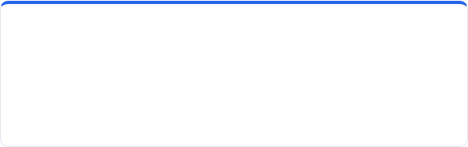
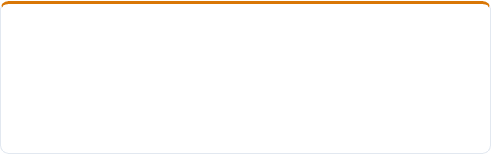

Q4. Recommend inventory adjustments for underperforming and high-demand products.
Product Units Sold Vs Units in Stock
Product Name | Total Units Sold | Total Inventory | Total Revenue | Inventory Turnover
Baby Doll Deluxe | 6.85K | 59.16K | ₹4.44M | 62.71
Princess Doll | 6.73K | 56.24K | ₹3.70M | 63.32
Robo Defender | 6.27K | 58.29K | ₹5.01M | 56.61
SuperHero Warrior | 5.83K | 52.45K | ₹4.08M | 52.49
Jigsaw Puzzle 500 | 4.90K | 62.69K | ₹2.20M | 43.88
Monopoly Classic | 4.80K | 62.71K | ₹4.80M | 42.56
Animal Puzzle | 4.69K | 60.66K | ₹1.87M | 43.28
Adventure Puzzle | 4.68K | 57.90K | ₹2.34M | 42.76
Family Ludo | 4.62K | 61.64K | ₹1.38M | 40.48
Chess Master | 4.24K | 59.00K | ₹2.33M | 36.91
High-demand & Fast-moving
Lower-demand & Slower-moving
Prioritize By Demand + Efficiency
Baby Doll Deluxe: 6.85K units | ₹4.44M | 62.71× turnover
Princess Doll: 6.73K | ₹3.70M | 63.32×
Action: Maintain strong allocation for high-demand, efficiently moving products.
Chess Master: 4.24K units | ₹2.33M | 36.91× turnover
Family Ludo: 4.62K | ₹1.38M | 40.48×
Action: Reduce future allocation for lower-demand, slower-moving products.
Robo Defender: 6.27K units | ₹5.01M | 56.61×
SuperHero Warrior: 5.83K | ₹4.08M | 52.49×
Action: Protect allocation for commercially important products with strong demand and turnover.
ToyJoy Seasonal Inventory Management & Optimization Analysis
Slide 7 of 11

Slide 8
Q5. Suggest strategies to optimize reorder points and quantities to reduce overstock and stockouts.
Product Name | Inventory Turnover | Stockout Count | Excess Inventory Value | Recommended Action
Princess Doll | 63.32 | 5 events | ₹19.29M | Increase ROP & safety stock; replenish more frequently
Baby Doll Deluxe | 62.71 | 2 events | ₹24.33M | Increase ROP selectively; monitor excess stock closely
Robo Defender | 56.61 | 0 | ₹29.91M | Maintain ROP; reduce order quantity to control excess
SuperHero Warrior | 52.49 | 2 events | ₹23.17M | Increase ROP moderately; replenish more frequently
Jigsaw Puzzle 500 | 43.88 | 0 | ₹15.58M | Maintain lower ROP; reduce reorder quantity
Animal Puzzle | 43.28 | 0 | ₹13.27M | Maintain lower ROP; avoid large replenishment batches
Adventure Puzzle | 42.76 | 0 | ₹16.08M | Reduce reorder quantity; replenish conservatively
Monopoly Classic | 42.56 | 0 | ₹37.43M | Lower reorder quantity; tightly control replenishment
Family Ludo | 40.48 | 0 | ₹11.03M | Lower ROP & reorder quantity; replenish conservatively
Chess Master | 36.91 | 0 | ₹17.61M | Lowest ROP & reorder quantity; minimize replenishment
Increase Replenishment
High Turnover + Recurring Stockouts
Princess Doll | Baby Doll Deluxe| SuperHero Warrior
↓
Higher reorder point + more frequent replenishment
Reduce Reorder Quantity
Lower Inventory Turnover
Chess Master | Family Ludo
↓
Lower purchase quantities + monitor excess
Controlled Replenishment
High Excess Inventory + Moderate Turnover
Monopoly Classic
↓
Avoid aggressive replenishment; review inventory before reordering.
Fast-moving + Stockout Risk
Princess Doll: 63.32 turnover + 5 stockouts.
Baby Doll Deluxe: 62.71 + 2 stockouts.
SuperHero Warrior: 52.49 + 2 stockouts.
Action: Increase reorder priority and replenish more frequently.
Slower Inventory Movement
Chess Master: lowest turnover at 36.91.
Family Ludo: 40.48 turnover.
Action: Reduce future reorder quantities to limit excess inventory.
High-value Excess Risk
Monopoly Classic: ₹37.43M excess inventory.
Turnover is only 42.56, below the portfolio high of 63.32.
Action: Maintain controlled replenishment and closely monitor stock before reordering.
ToyJoy Seasonal Inventory Management & Optimization Analysis
Slide 8 of 11

Slide 9
Store Performance & Inventory Allocation Analysis
Revenue & Excess Inventory Value by Store ID (₹ M)
Store ID | Net Revenue | Total Units | Turnover Rate | Stock Outs | Top 3 Product Volume Drivers (Units Sold)
Store001 | ₹4.24 M | 6,969 | 61.60x | 3 | Baby Doll Deluxe (1,148) | SuperHero Warrior (895) | Princess Doll (859)
Store002 | ₹4.12 M | 6,887 | 59.85x | 1 | Princess Doll (1,044) | Robo Defender (1,008) | Baby Doll (754)
Store006 | ₹4.02 M | 6,657 | 63.45x | 0 | Robo Defender (1,065) | Baby Doll (966) | SuperHero (757)
Store007 | ₹4.08 M | 6,722 | 60.12x | 1 | Baby Doll Deluxe (950) | Princess Doll (866) | Robo Defender (746)
Store004 | ₹3.99 M | 6,645 | 60.01x | 0 | Baby Doll Deluxe (777) | SuperHero (769) | Princess Doll & Jigsaw Puzzle 500 (759)
Store005 | ₹3.97 M | 6,704 | 59.20x | 2 | Princess Doll (925) | Baby Doll (895) | SuperHero (739)
Store008 | ₹3.90 M | 6,629 | 59.08x | 2 | Robo Defender (847) | Adventure Puzzle (761) | Jigsaw 500 (731)
Store003 | ₹3.81M | 6,388 | 60.81x | 0 | Princess Doll (868) | Baby Doll (775) | SuperHero (747)
High-Volume Store Bottlenecks
Store006 : Efficiency Benchmark
Store008 — Puzzle Demand
Store001 & Store002
Contribute 26.01% of revenue (₹8.36M)
44.4% of stockouts (4/9)
→ Prioritize replenishment review.
Highest inventory turnover (63.45×)
No recorded stockouts
Lowest inventory holding (68.4K units)
→ Benchmark for efficient replenishment.
Highest volume of Puzzles sold.
Adventure Puzzle (761), Jigsaw Puzzle 500 (731) and Animal Puzzle (685)
→ Allocate more puzzle inventory to Store008.
EXECUTIVE TAKEAWAY: Replace uniform chain-wide replenishment with store-cluster allocation. Prioritize puzzle inventory allocation toward Store008 based on higher observed puzzle demand, while increasing replenishment frequency for star Doll and Action Figure SKUs at Store001 and Store002.
ToyJoy Seasonal Inventory Management & Optimization Analysis
Slide 9 of 11

Slide 10
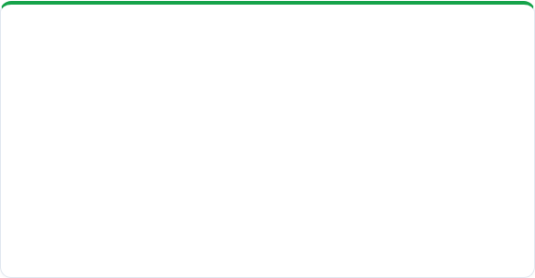

Strategic Recommendations & Action Plan
QUICK WINS (0–3 Months)
LONG-TERM STRATEGIES (3–12 Months)
Rebalance Overstock: Execute promotional bundling for Monopoly Classic (₹37.43M excess) to free up warehouse space.
Elevate Princess Doll Buffer: Increase safety-stock coverage for Princess Doll and monitor stockout recurrence to prevent repeat stockouts.
Festive Pre-build: Initiate festive procurement 6 weeks in advance (Aug/Sep) to capture the 19.5K unit seasonal surge.
Slow-Mover Reorder Freeze: Reduce reorder quantities for Chess Master & Family Ludo and monitor excess inventory.
Power BI Automated Forecasting: Implement real-time Power BI inventory alerts linked with store transactions.
Supplier Lead-Time Audit: Partner with manufacturers to reduce procurement lead times for Star SKUs.
Warehouse Optimization: Reallocate shelf capacity from Board Games toward high-turnover Dolls & Action Figures.
Stimulate Off-Peak Demand: Test gifting bundles and back-to-school kits during weaker periods—Back to School (3.72K), Financial Year End (3.81K), and Christmas/New Year (3.82K)—to increase sales during these periods.
ToyJoy Seasonal Inventory Management & Optimization Analysis
Slide 10 of 11

Slide 11

Thank You | Questions & Discussion
Prepared by Agamya Jain | Data Analyst | Business Intelligence & Analytics Department ToyJoy
Slide 11 of 11

